Slide 1

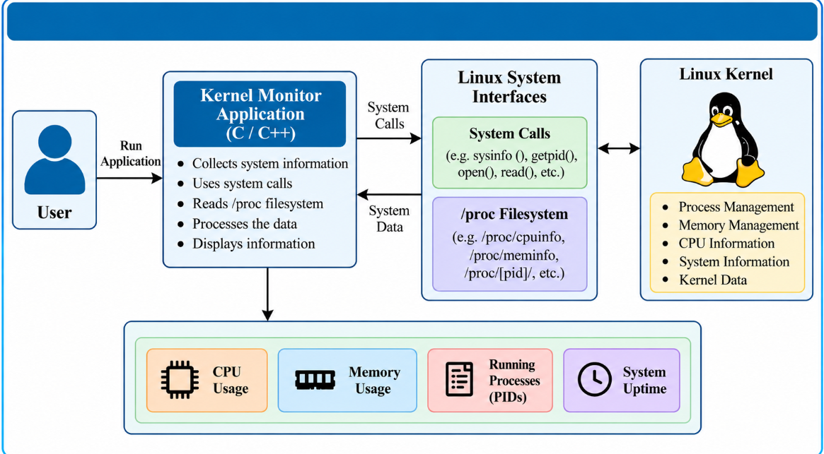
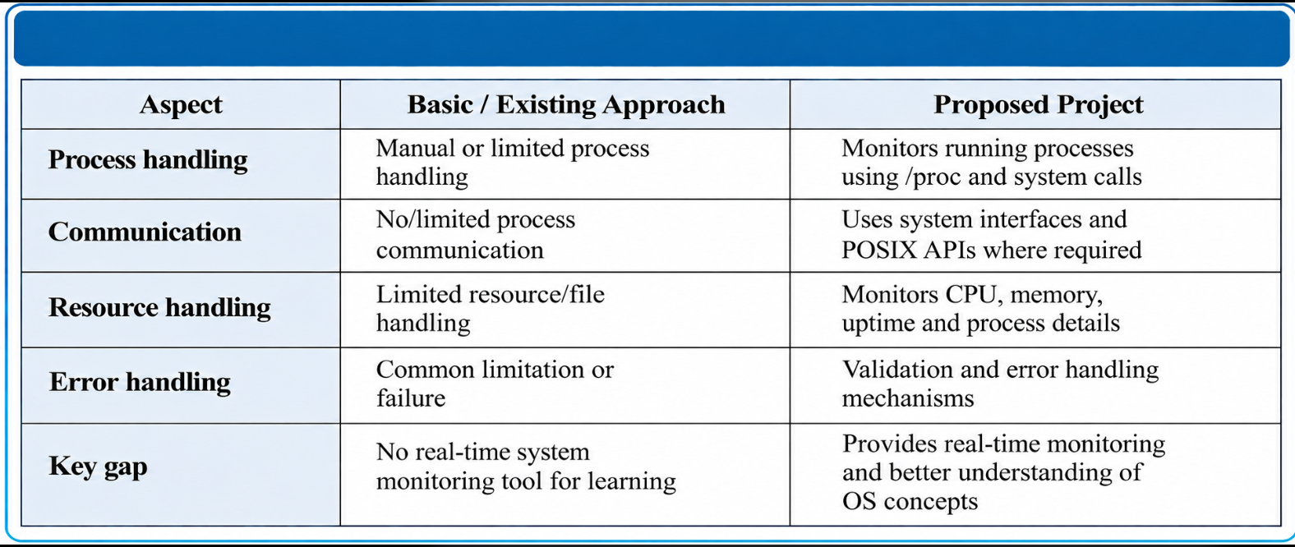
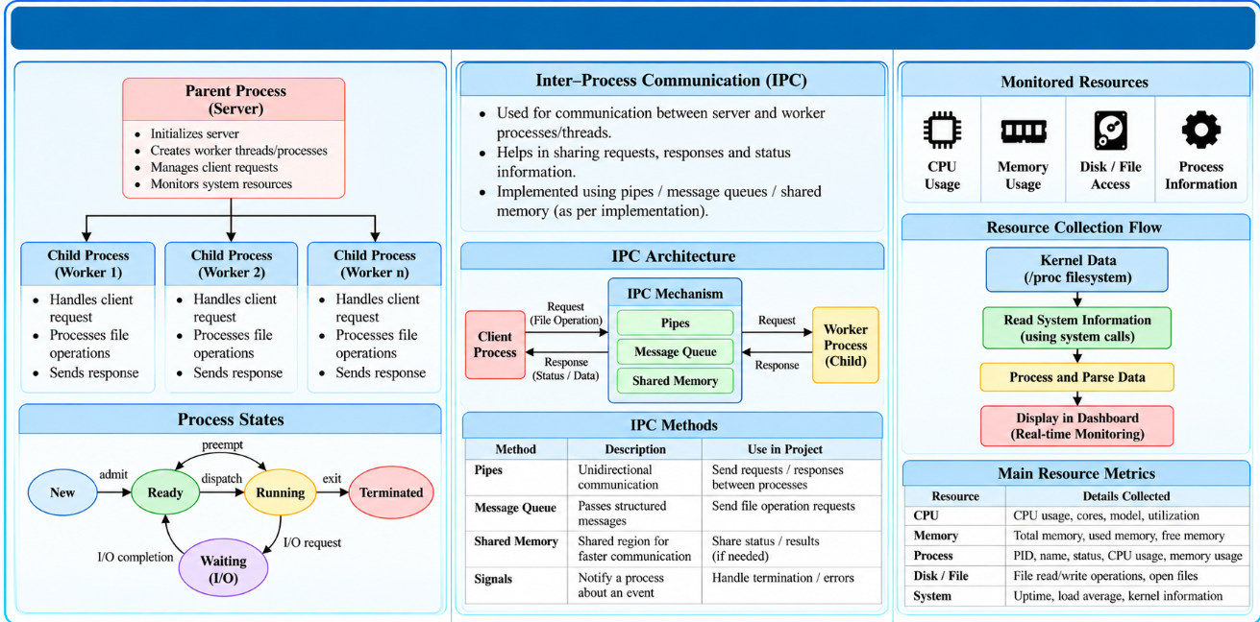
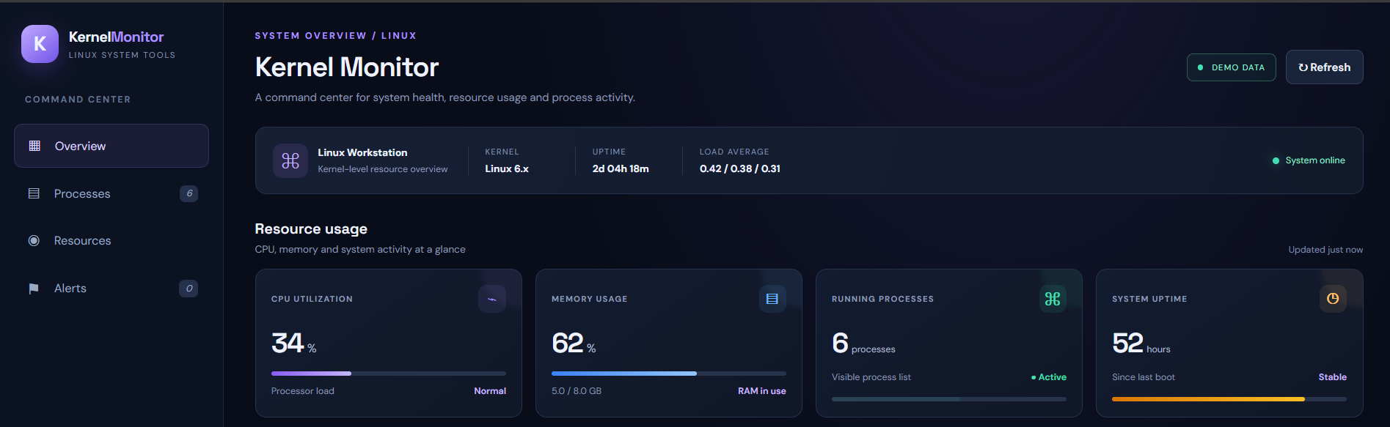
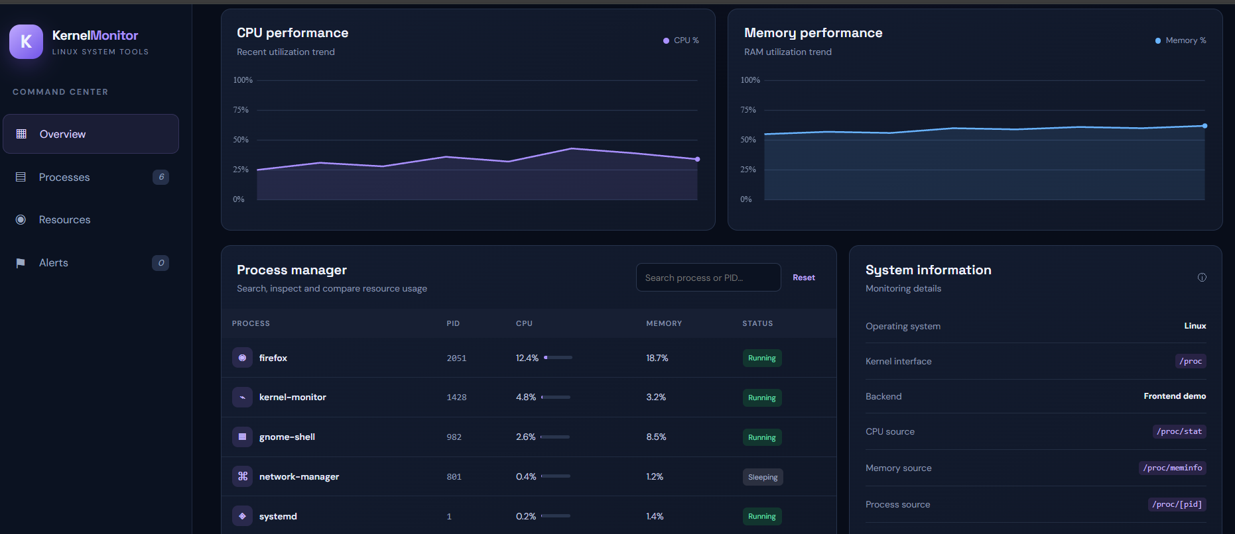

KLH Logo
[KERNAL MONITER]
Team ID: [26] | Section: [S12] | Members: [R SAI CHARAN REDDI – 2520090184], [G MANIDEEP –2520090100], [P AKHIL YADAV – 2520090155] | Guide: [M.RAGHUPATHI]
OPERATING SYSTEM AND SYSTEMS PROGRAMMING (25CS2104E) | KLH Bachupally Campus, CS&IT | PBL 2026-27
Abstract
Tools & Technologies
ABSTRACT
Kernel Monitor is a Linux-based system monitoring project designed to observe and display important operating system and kernel-level information in a user-friendly manner. The project focuses on understanding how the Linux kernel manages system resources such as CPU, memory, processes, and system information. It uses Linux system interfaces, system calls, and the /proc virtual filesystem to collect and analyze real-time system information.
The expected outcome is a lightweight Kernel Monitor that helps users observe system resources and understand the interaction between user programs and the Linux operating system kernel.
T
Programming Language: C / C++
Platform: Linux / Ubuntu
Kernel Interface: /proc Virtual Filesystem
System Calls / APIs: sysinfo(), getpid(), getppid(), open(), read(), close(), opendir(), readdir(), closedir()
Compiler: GCC / G++
Development Tools: VS Code, Vim, Nano
Version Control: Git & GitHub
Operating System Concepts: Process Management, Process Identification, CPU Utilization, Memory Management and POSIX APIs.
Problem Statement & Objectives
Problem: Understanding real-time CPU, memory, and process utilization at the kernel level is difficult without proper monitoring tools.
Objectives:
Develop a Linux-based system monitoring application.
Monitor CPU, memory, uptime, and running processes.
Retrieve system information using Linux system calls and the /proc filesystem.
Demonstrate process and memory management concepts.
Scope: Real-time system monitoring using C/C++ in Linux/Ubuntu.
System Architecture
[Insert architecture diagram: Front-End – REST API – Database]
Existing vs Proposed System
Process, IPC & Resource Design
[Insert ER diagram with entities, keys and relationships]
Feasibility Study
1. Technical Feasibility: Uses C/C++, Linux/Ubuntu, system calls, and the /proc filesystem for system monitoring.
2. Economic Feasibility: Uses open-source tools such as GCC, Linux, and VS Code with minimal cost.
3. Operational Feasibility: Easy to use, lightweight, and suitable for students and developers.
4. Schedule Feasibility: Can be developed and tested within the semester timeline.
Implementation Screenshots
[Screenshot 1]
[Screenshot 2]
Results & Testing
Conclusion
Future Scope
Displays CPU and memory usage.
Monitors running processes and PIDs.
Shows system uptime.
Normal input testing.
Process and resource monitoring.
Error and file-access testing.
Successfully demonstrates Linux system monitoring.
Monitors CPU, memory, uptime, and running processes.
Uses /proc filesystem and Linux system calls.
Improves practical understanding of OS and kernel concepts.
Add automatic real-time monitoring.
Introduce CPU and memory usage alerts.
Add process search and filtering.
Improve dashboard design and performance.
Maintain historical system usage data.
References: [1] [Author, Title, Year] [2] [Website / Documentation link] [3] [Paper / Book]
QR: GitHub

